Slide 1

PROPERTY TAX

Slide 2



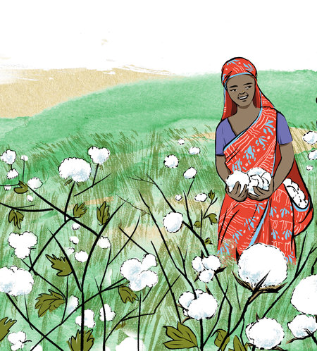
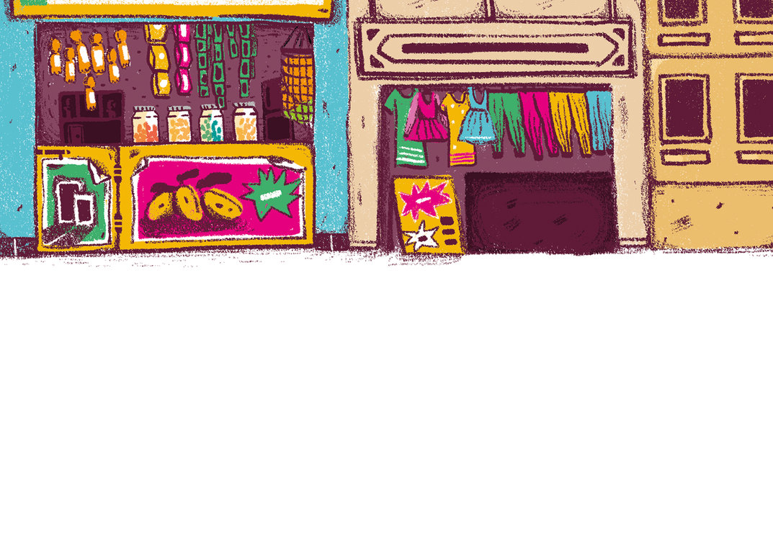
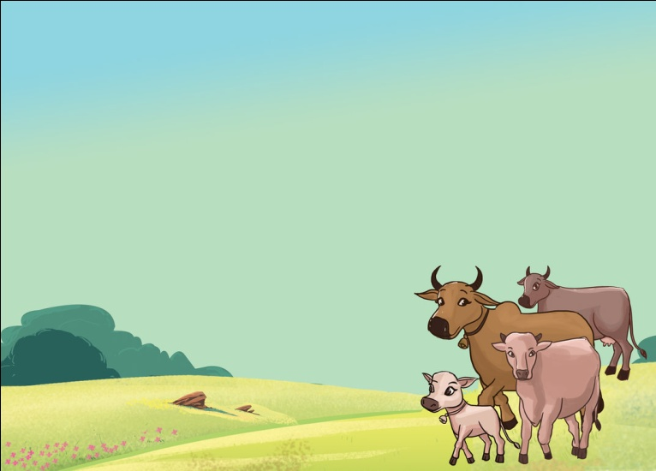
What is Property Tax?
Tax that is paid for owning real estate
Property Tax is applicable on:
Property Tax is not applicable on:
Property consisting of land or buildings
Farmland with no buildings
Property owned for living purpose
Property owned for running a shop or business
Vacant plots of land

Slide 3
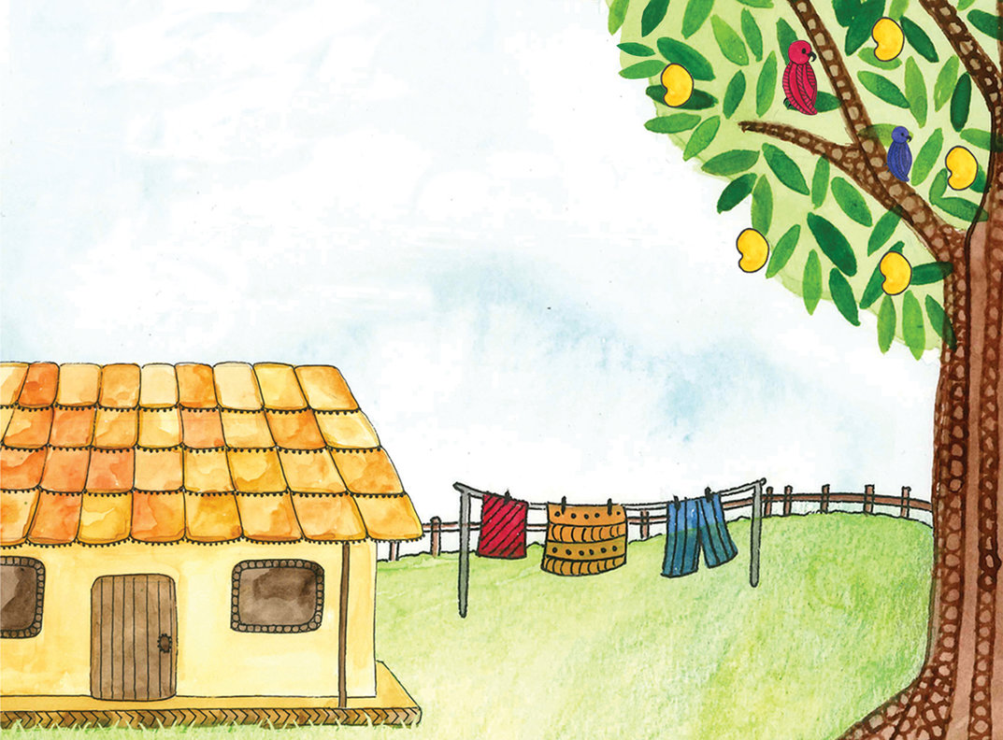
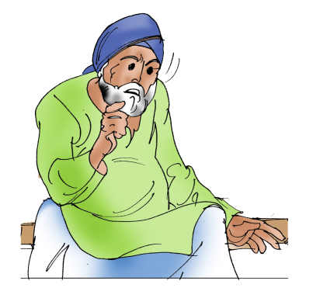

Who pays Property Tax?
The Owner of the property has to pay Property Tax
Even if he/she does not live in or use the property

Slide 4

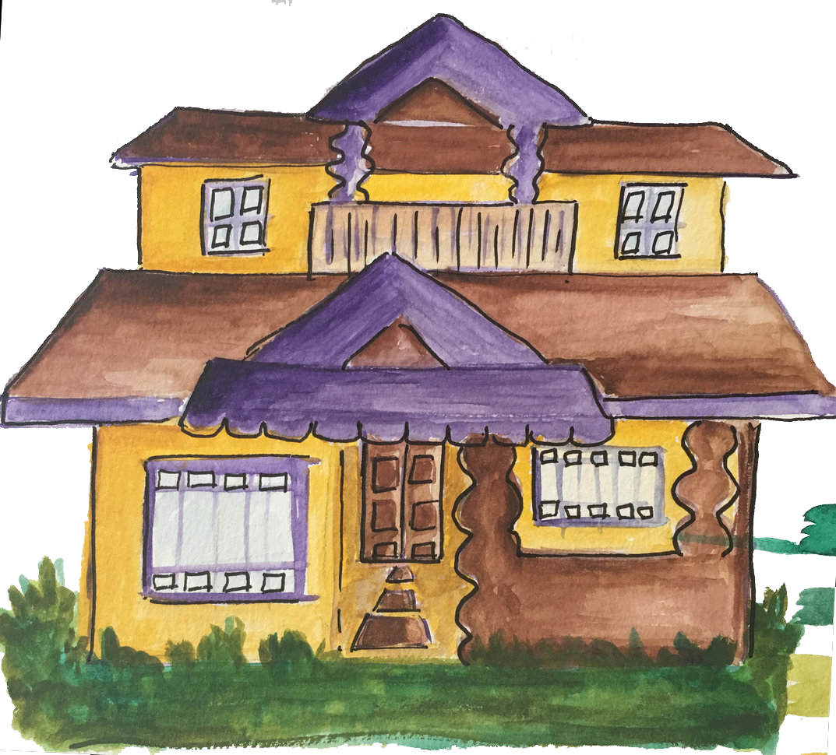
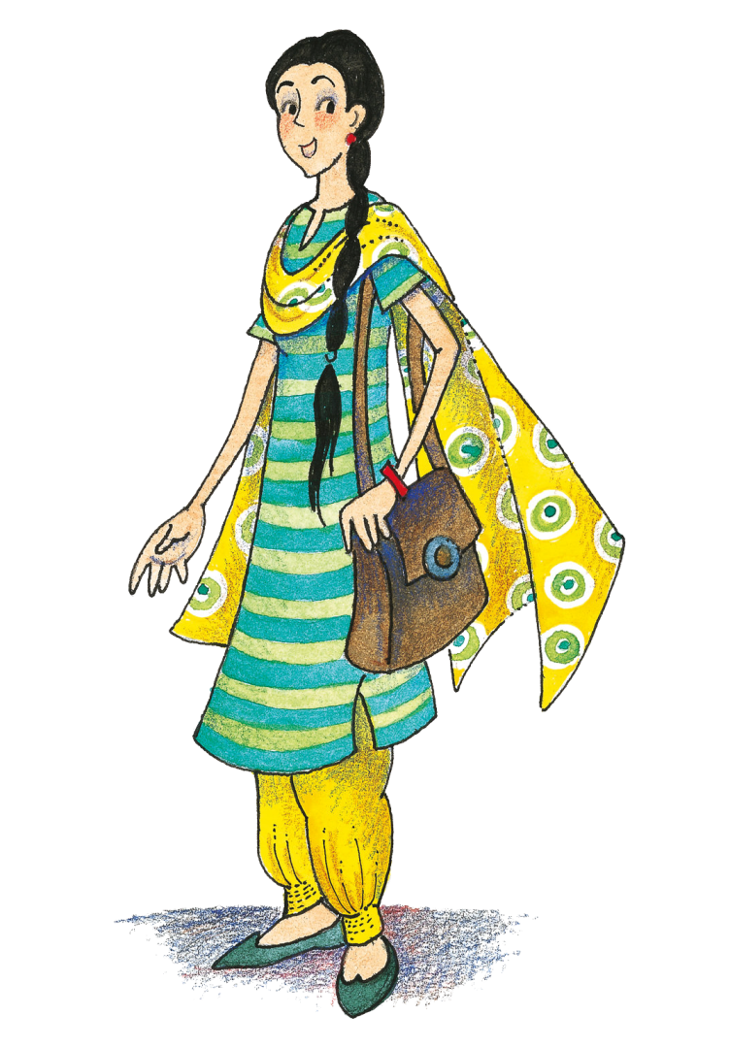
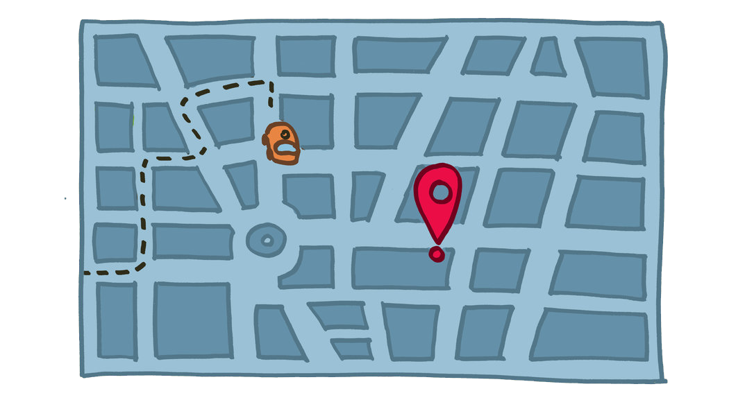

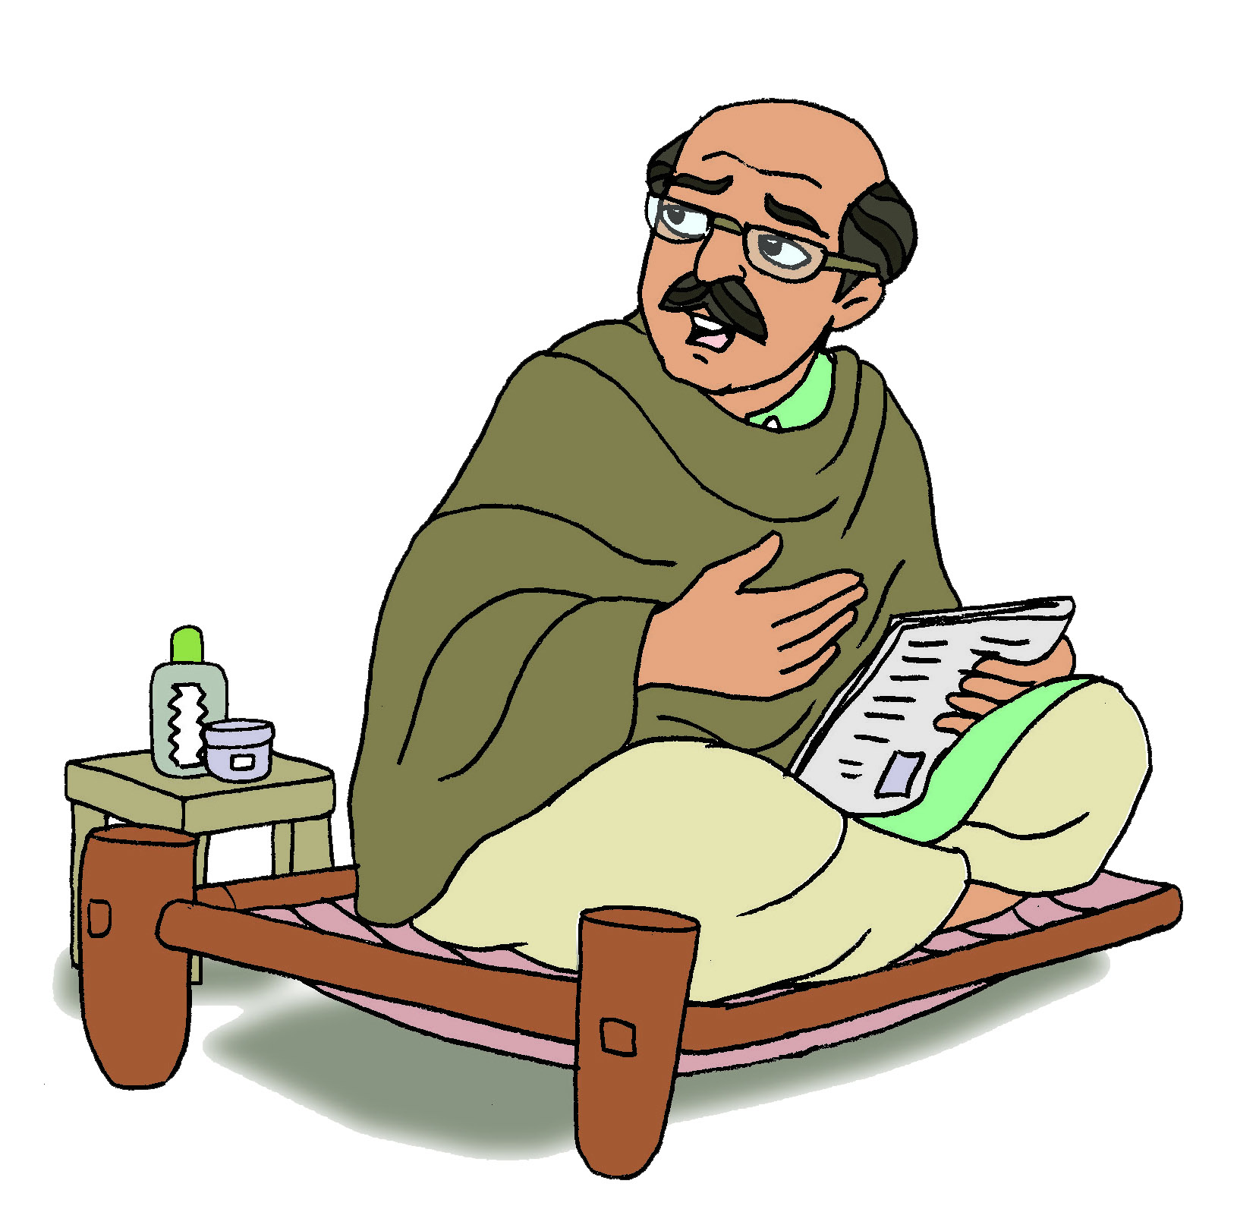
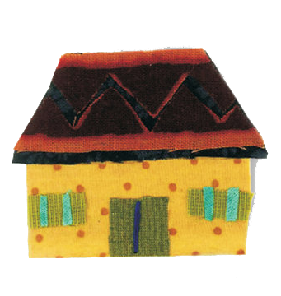
How much Property Tax do I have to pay?
Property Tax is calculated based on:
Location of the Property
Size of the Property
Age
Gender

Slide 5
When and how do I pay property tax?
Property Tax is generally paid every six months starting from the 1st of April
April
September
June
July
August
May
1
30
Property Tax can be paid:
2017
2017
Online on the local property tax website
And
By Cheque
October
March
November
February
December
January
1
31
2017
2018
2017

Slide 6

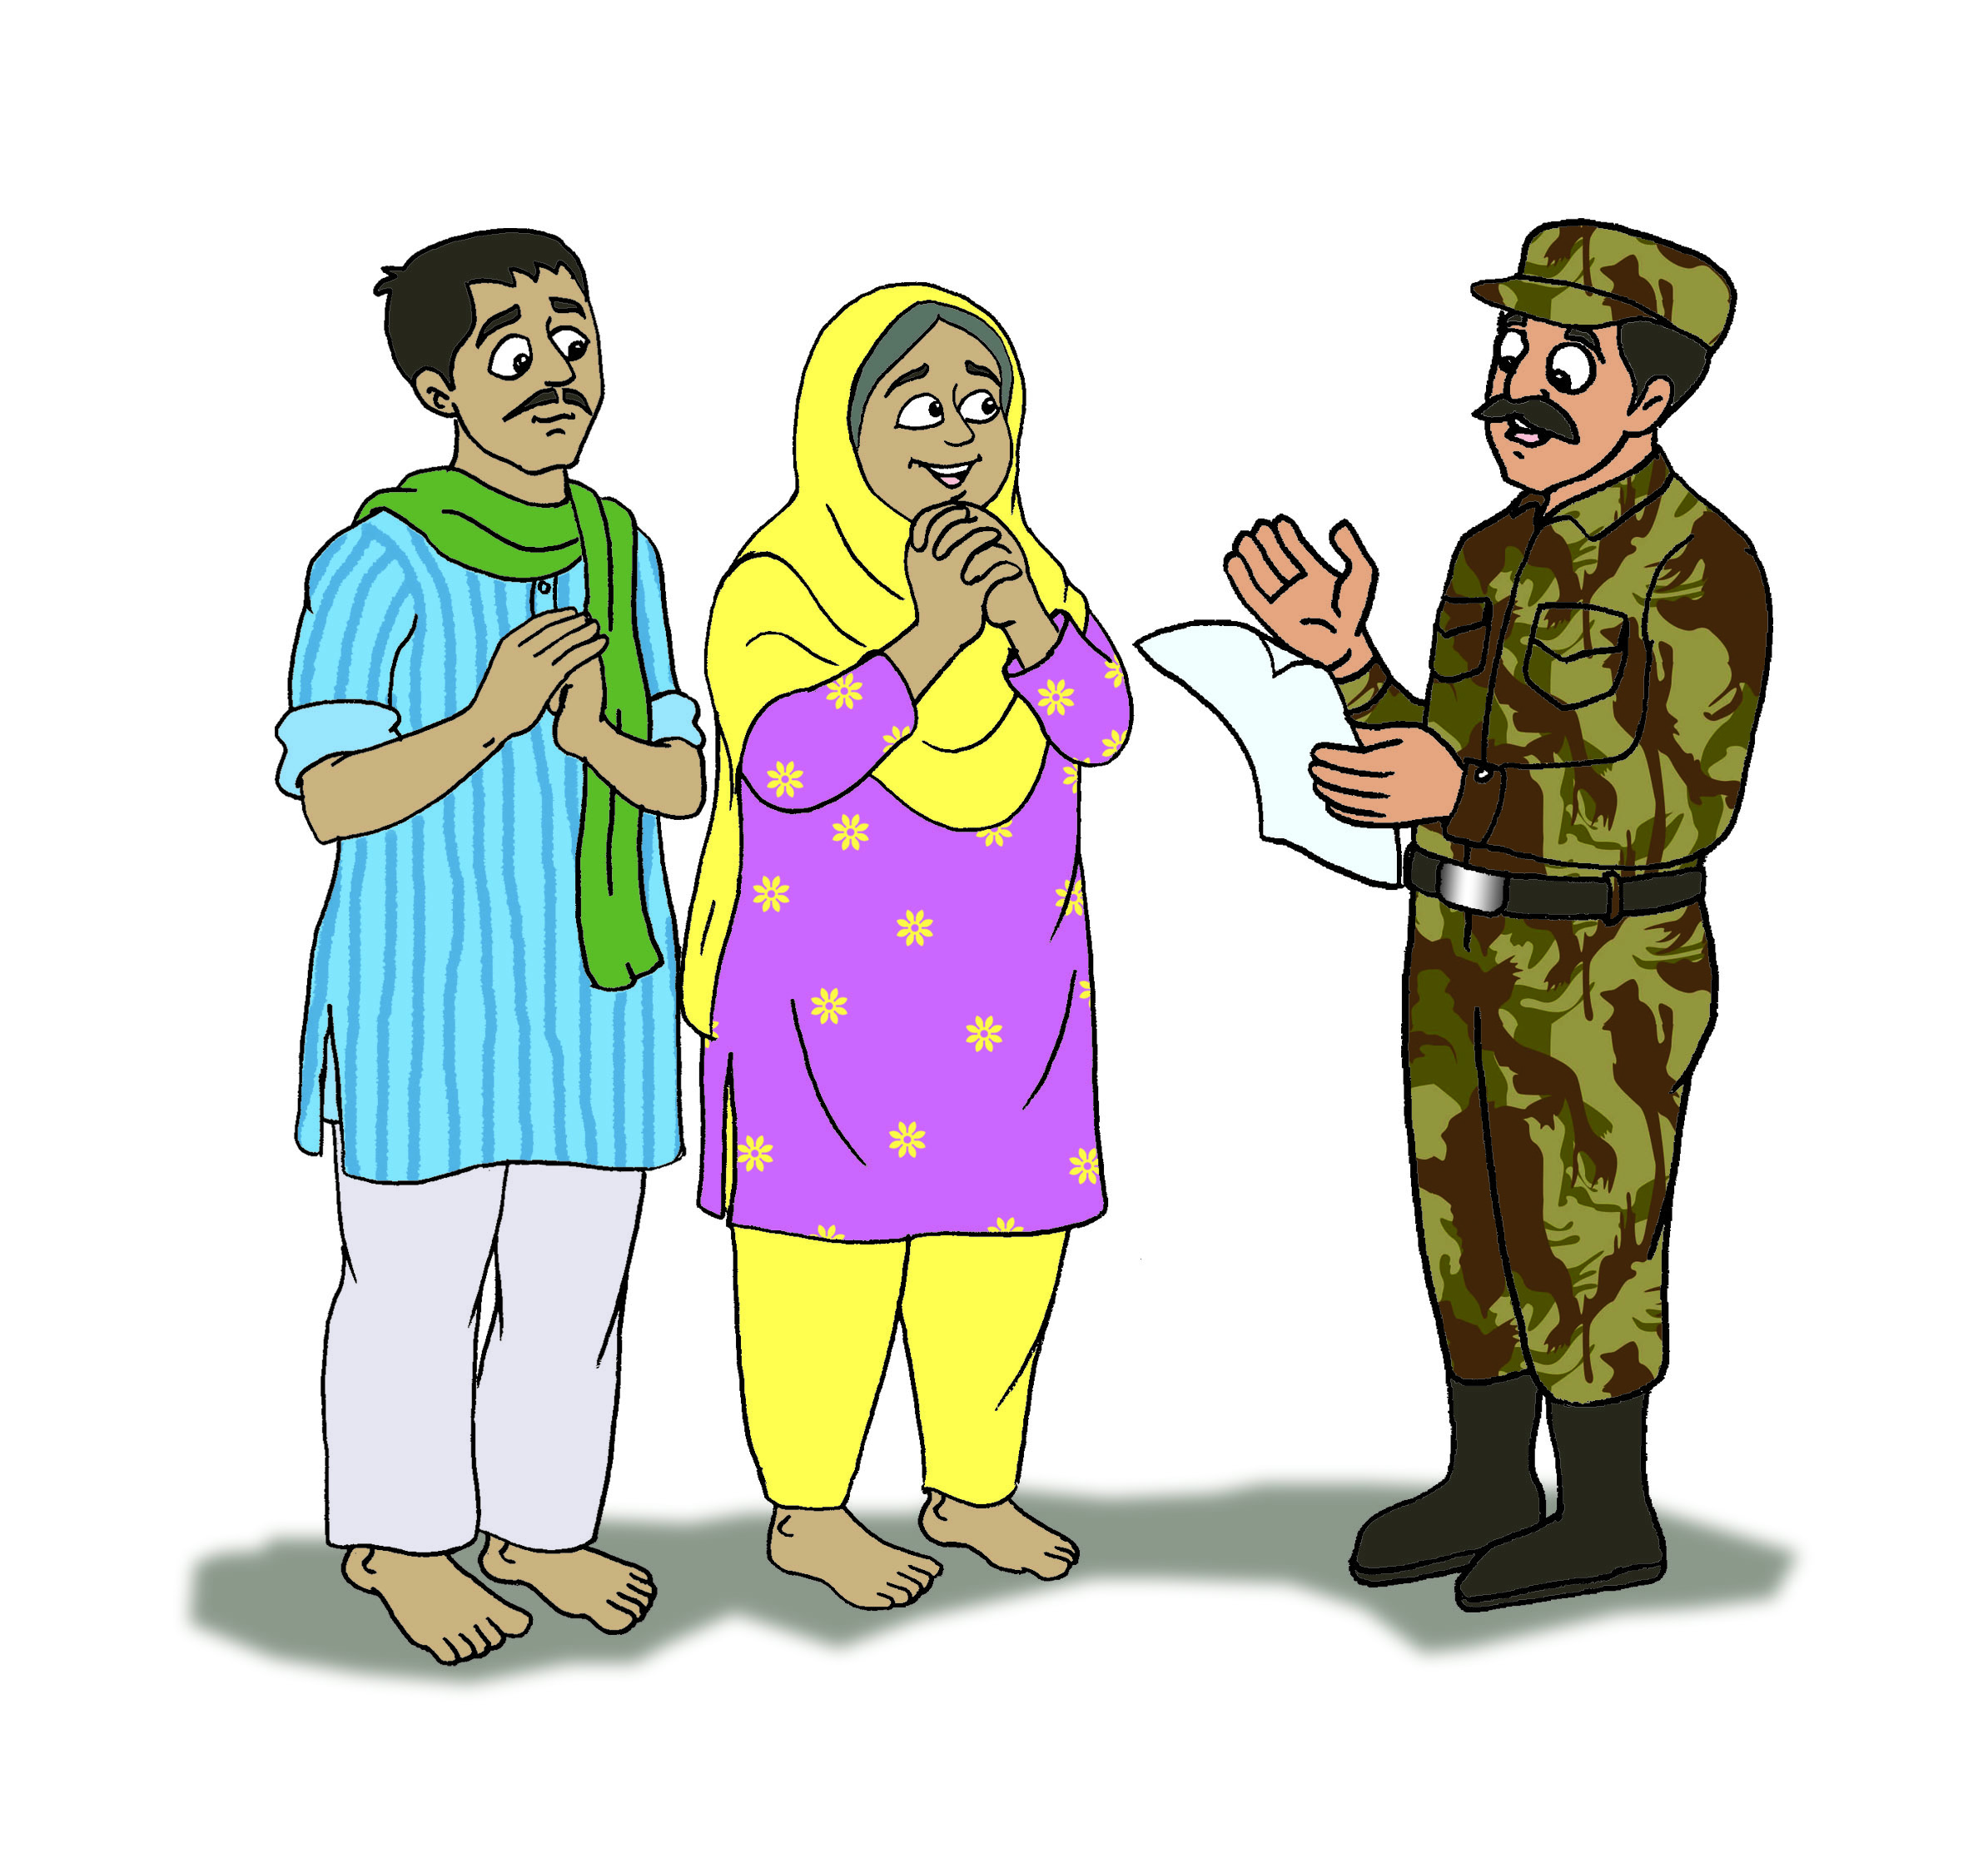
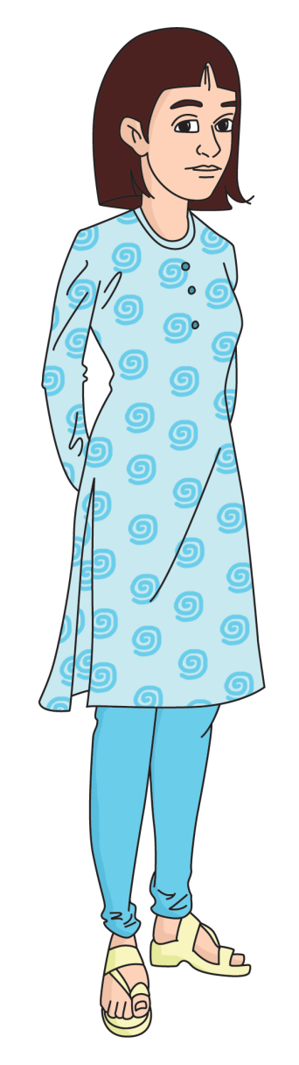
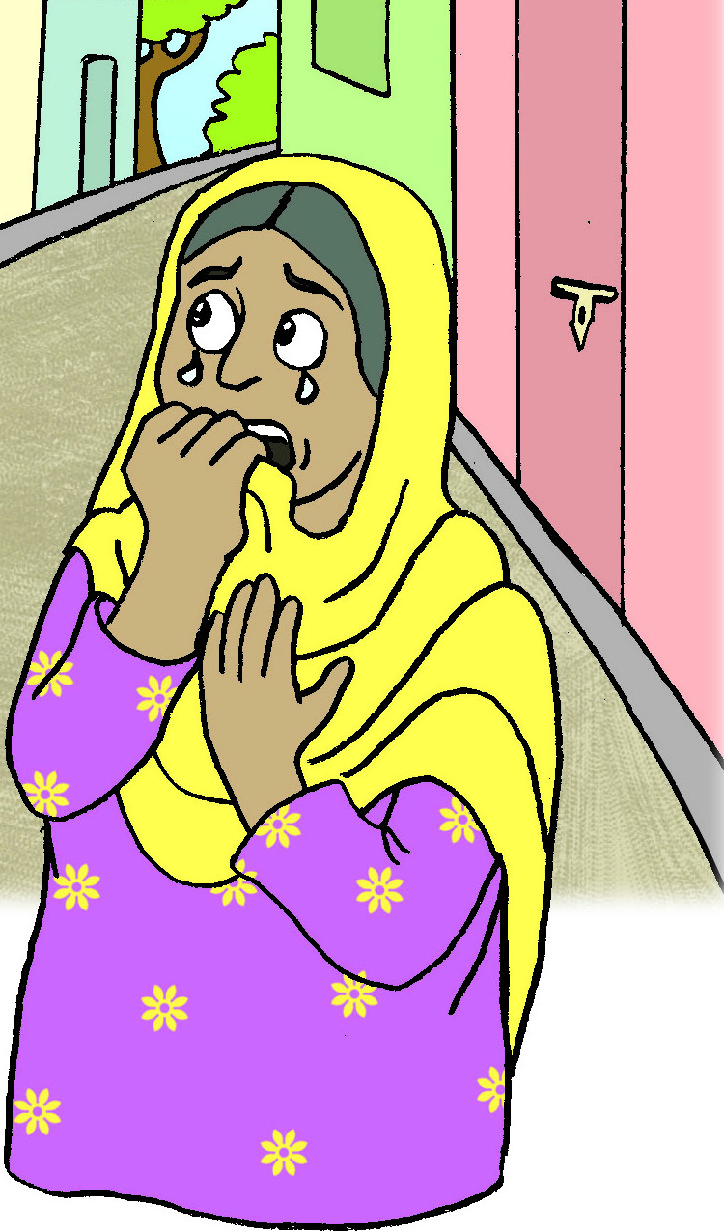
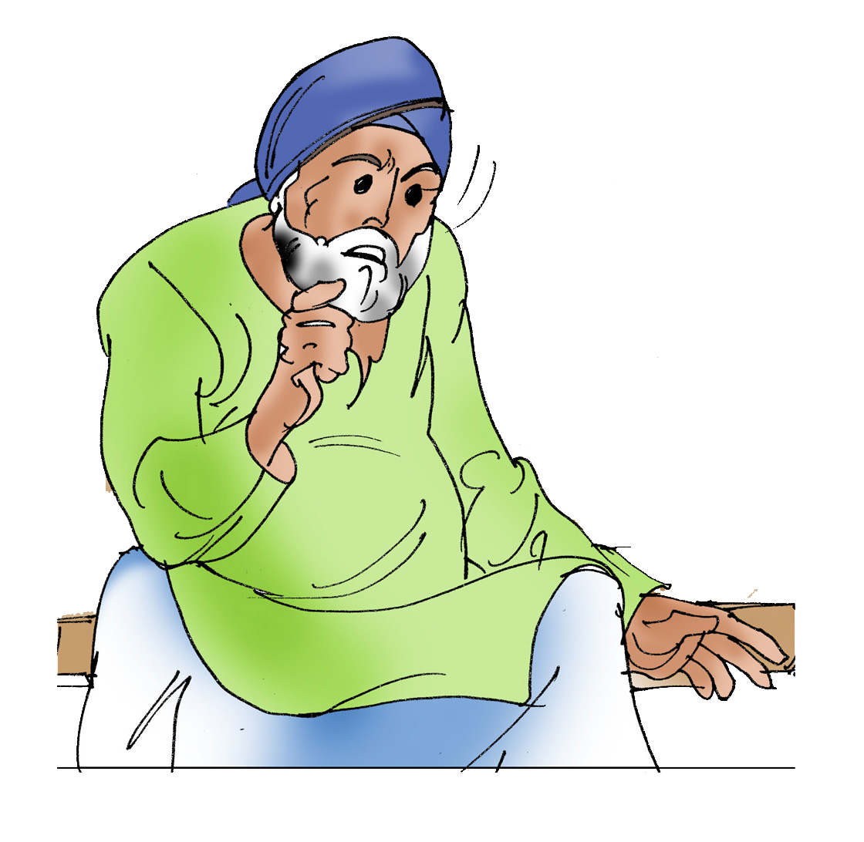



Is exemption or concession possible?
I pay property tax for the whole year at one time and I pay very early. Will I get concession?
I am a proud member of the Indian Army. Do I have to pay property tax for my small flat?
We have a solar powered water heater at home! Do we get a concession?
I am a widow. Do I need to pay property tax?
I am 82 years old. Do I need to pay property tax?
With or without concession, Property Tax must be paid
If not paid, assets or property may be seized!
For one house only
A concession of 5%
A concession of 2%
With a concession of 10%
With concession for senior citizens (over 80 years)

Slide 7
That’s all about
PROPERTY TAX

